Slide 1

Mentoring Project
ENEM Grade Prediction – Hypotheses and Model
Mentor: Carlos Eduardo Mello
Mentee: Higor de Faria

Slide 2
Summary
Problem Framing
Hypotheses
Hypotheses Results
Prediction Models

Slide 3
Problem Framing / Exposition
In the 90’s, university admission in Brazil was decentralized (each university had its own exam) and unfair to students living far from capitals
ENEM implementation in 1998: One measuring tool for admission in many universities
Democratic
Quality of life change for students
The admission process is inherently biased: better life conditions tend to produce better grades
Project objective: Analysis of factors in students' grades / Grade Prediction
Hypotheses formulation
Hypotheses testing
Problem Framing
Hypotheses
Hypotheses Results
Prediction Models

Slide 4
Problem Framing / Available Data
Data from ENEM’s Survey (Last Year: 2018)
Entries before Pre-Processing: 3.311.925 students
Entries after Pre-Processing: 2.336.904 students
Initial number of features: 113 (!!!)
5 Grades to be predicted:
Mathmetics (Float)
Languages and Codes (Float)
Human Sciences (Float)
Nature Sciences (Float)
Essay (Integers)
Problem Framing
Hypotheses
Hypotheses Results
Prediction Models

Slide 5
Hypotheses
Methodology:
Problem Framing > Domain Theory/Hypothesis > Modelling > Experiment > Problem Reframing
Proposal of hypothesis based on knowledge of the field:
Excessive number of features in provided dataset
Basis for feature choice
Checking of hypothesis:
Percentage of students in each grade category
Each subject had different grade ranges:
Grade category defined by percentiles in each subject
Hypotheses
Problem Framing
Hypotheses Results
Prediction Models

Slide 6
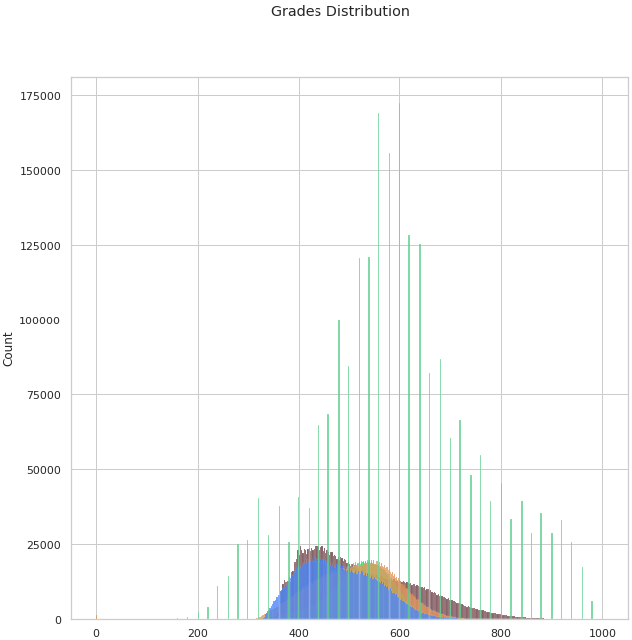
Hypotheses
Grades Percentiles Values: (25th/50th/75th)
Math : 436.8 / 503.9 / 600.6
Languages: 488 / 529.4 / 567.7
Human Sciences: 453.6 / 515.7 / 570.1
Nature Sciences: 419.4 / 472.3 / 534.8
Essay: 500 / 580 / 680
Grade categories:
Very Low performance: Below 25th
Low performance: Between 25th and 50th
Average performance: Between 50th and 75th
High performance: Above 75th
Hypotheses
Problem Framing
Hypotheses Results
Prediction Models

Slide 7
Hypotheses
High-Level Hypothesis: Students’ grades are a factor of social-economic background (including economic differences between Brazilian regions).
Low-Level Hypotheses (Social-Economic Factors):
Students from in the wealthiest regions (SE and S) perform better than students from the poorest regions (N and NE)
Students from private schools perform better than students from public schools
Students having higher educated parents perform better at the exam
Students with a greater monthly family income perform better at the exam
Students with more access to the internet perform better at the exam
Low-Level Additional Hypotheses:
There is a small age range where students perform better
Students taking the exam to test their knowledge perform better
Hypotheses
Problem Framing
Hypotheses Results
Prediction Models

Slide 8
Hypotheses Results
Each low-level hypothesis was checked using the provided ENEM data
Hypotheses and features analyzed:
Hyp. 1 (Brazilian regions): SG_UF_PROVA
Hyp. 2 (Public x Private): TP_ESCOLA
Hyp. 3 (Parents’ level of education): Q001 and Q002
Hyp. 4 (Monthly family income) : Q006
Hyp. 5 (Internet Access) : Q022 and Q025
Hyp. 6 (Age range of best grades) : NU_IDADE
Hyp. 7 (Trainer students) : IN_TREINEIRO
Hypotheses Results
Problem Framing
Hypotheses
Prediction Models

Slide 9
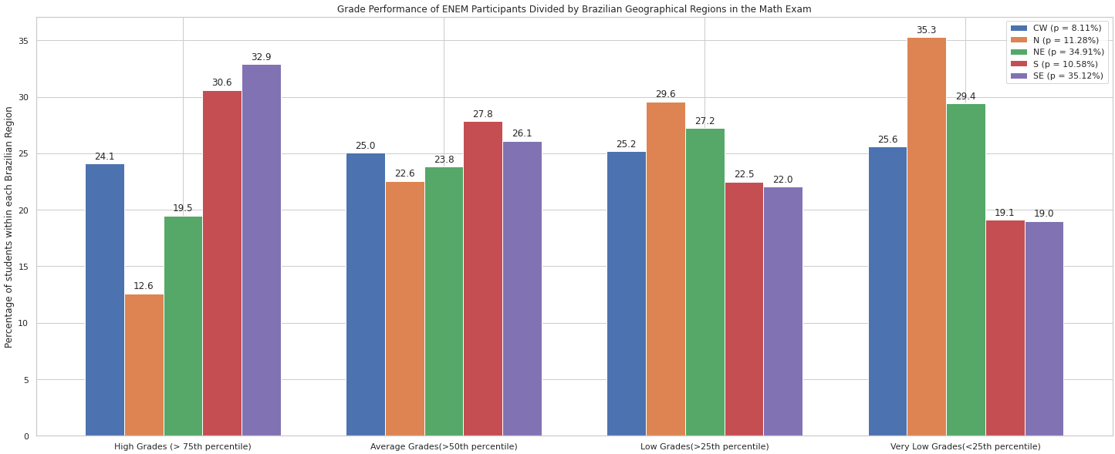
Hypotheses Results – Hypothesis 1
Obs.: Similar graphs occurred for Languages, Human Sciences and Nature Sciences
Hypotheses Results
Problem Framing
Hypotheses
Prediction Models

Slide 10
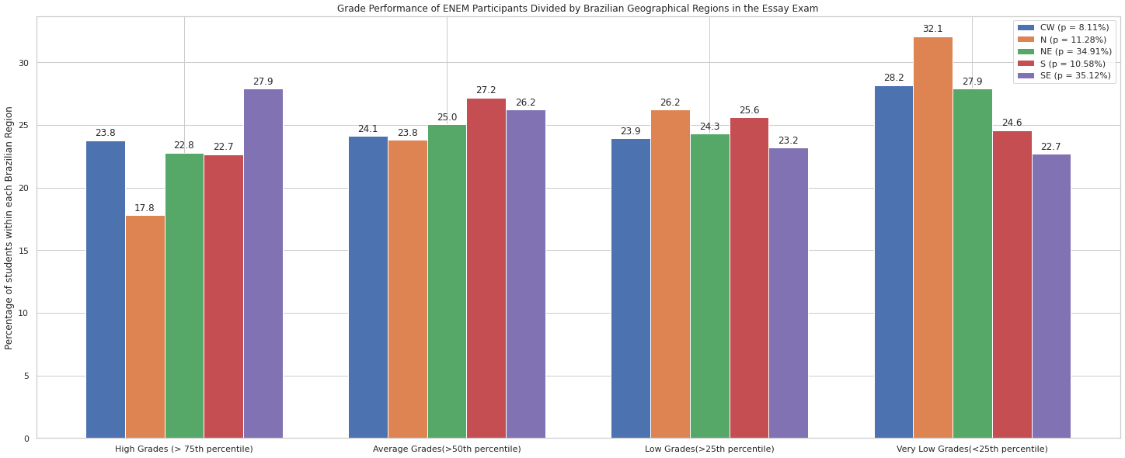
Hypotheses Results – Hypothesis 1 (Essay)
Hypotheses Results
Problem Framing
Hypotheses
Prediction Models

Slide 11
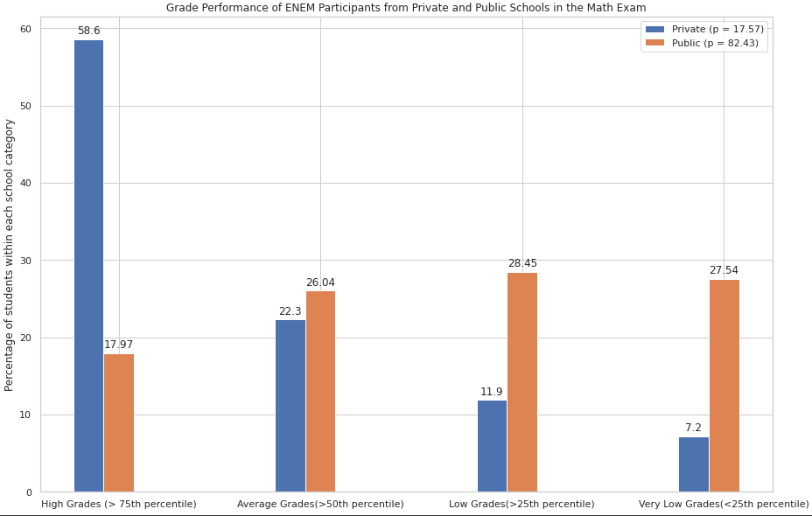
Hypotheses Results – Hypothesis 2
Obs.: Similar graphs occurred for all other subjects
Hypotheses Results
Problem Framing
Hypotheses
Prediction Models

Slide 12
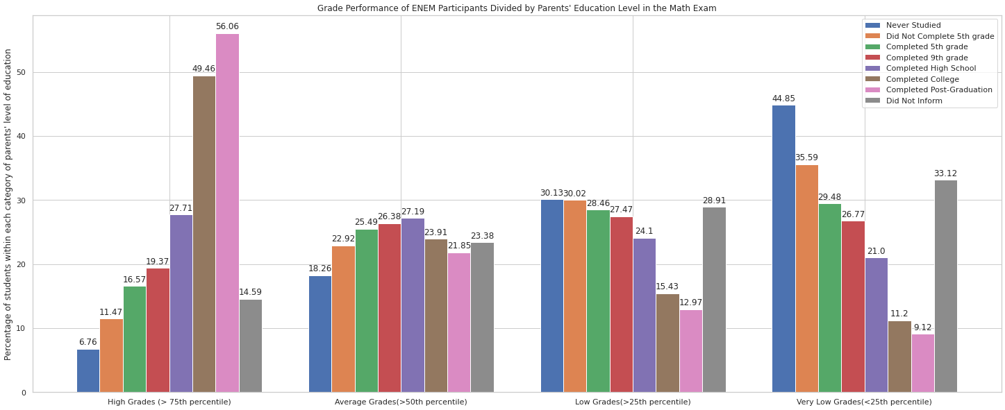
Hypotheses Results – Hypothesis 3
Obs.: Similar graphs occurred for all other subjects
Hypotheses Results
Problem Framing
Hypotheses
Prediction Models

Slide 13
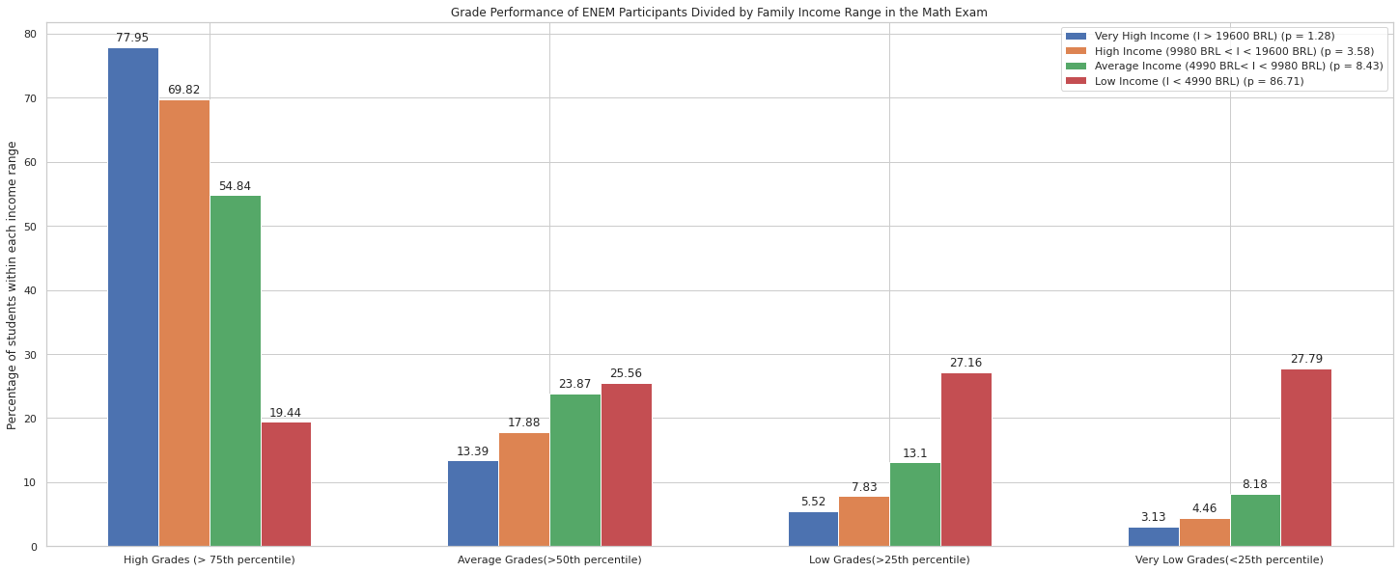
Hypotheses Results – Hypothesis 4
Obs.: Similar graphs occurred for all other subjects
Hypotheses Results
Problem Framing
Hypotheses
Prediction Models

Slide 14
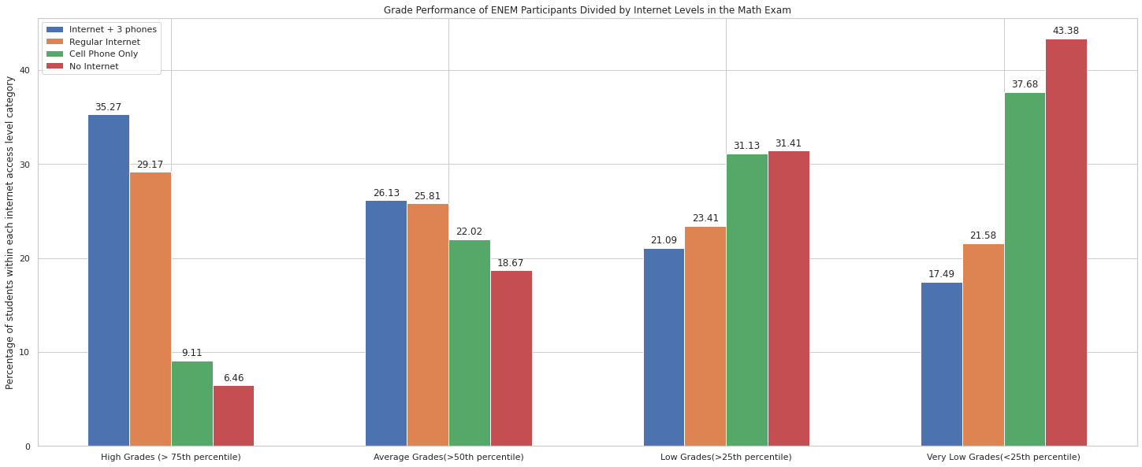
Hypotheses Results – Hypothesis 5
Obs.: Similar graphs occurred for all other subjects
Hypotheses Results
Problem Framing
Hypotheses
Prediction Models

Slide 15
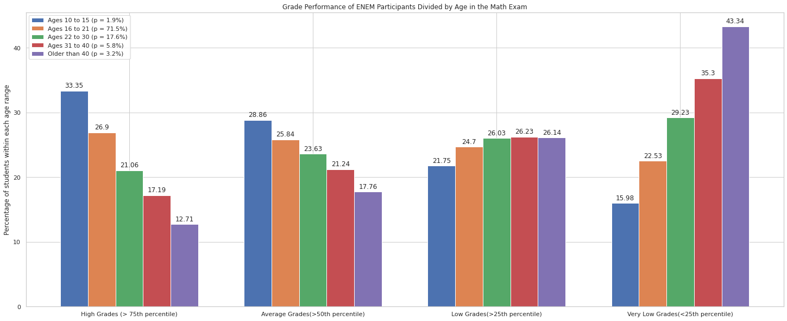
Hypotheses Results – Hypothesis 6 Math
Hypotheses Results
Problem Framing
Hypotheses
Prediction Models

Slide 16
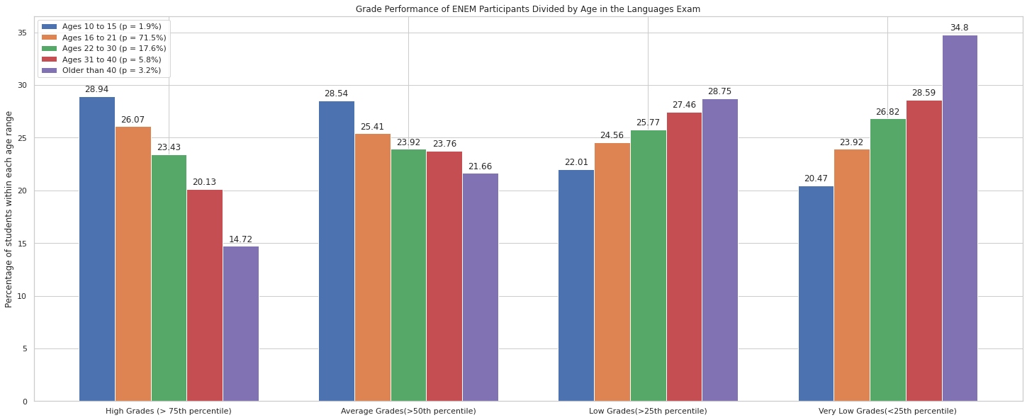
Hypotheses Results – Hypothesis 6 Languages
Hypotheses Results
Problem Framing
Hypotheses
Prediction Models

Slide 17
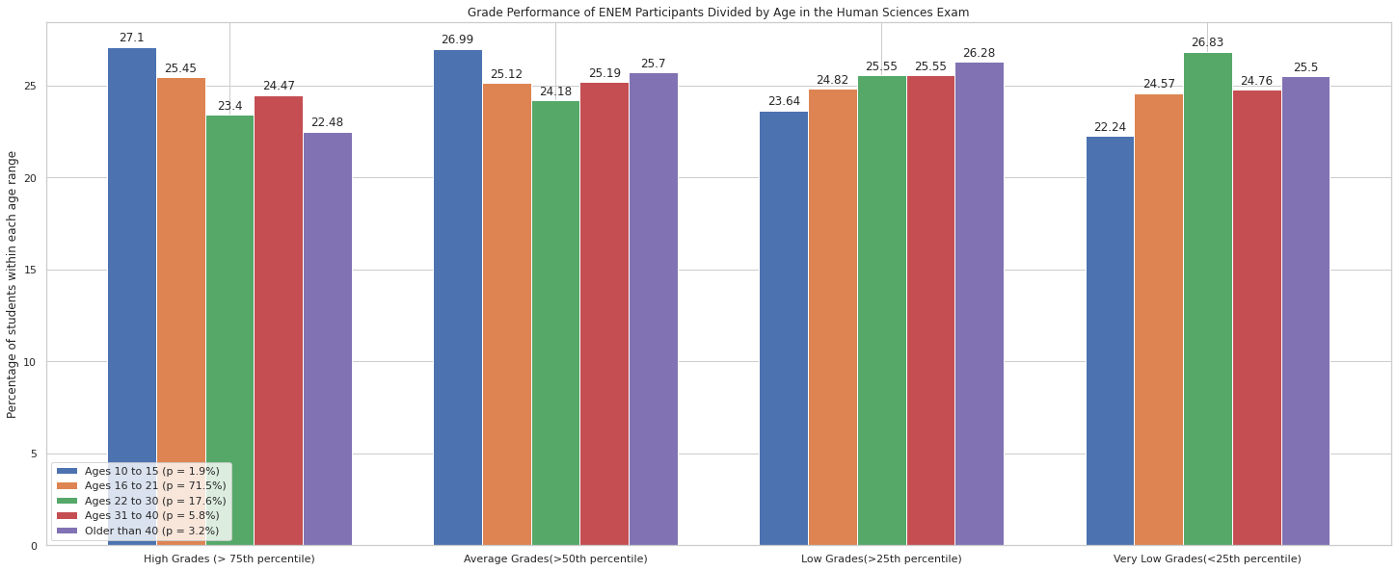
Hypotheses Results – Hypothesis 6 Human Sci.
Hypotheses Results
Problem Framing
Hypotheses
Prediction Models

Slide 18
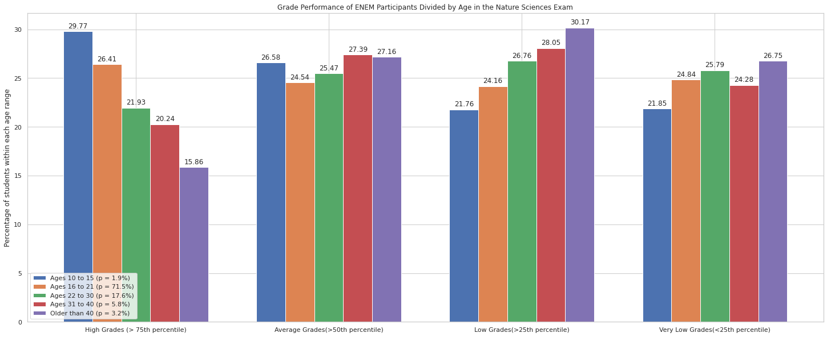
Hypotheses Results – Hypothesis 6 Nature Sci.
Hypotheses Results
Problem Framing
Hypotheses
Prediction Models

Slide 19
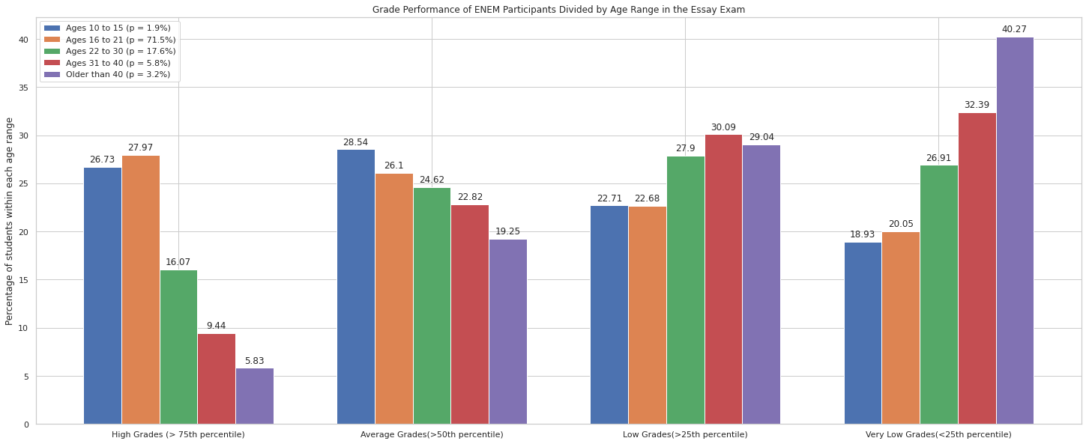
Hypotheses Results – Hypothesis 6 Essay
Hypotheses Results
Problem Framing
Hypotheses
Prediction Models

Slide 20
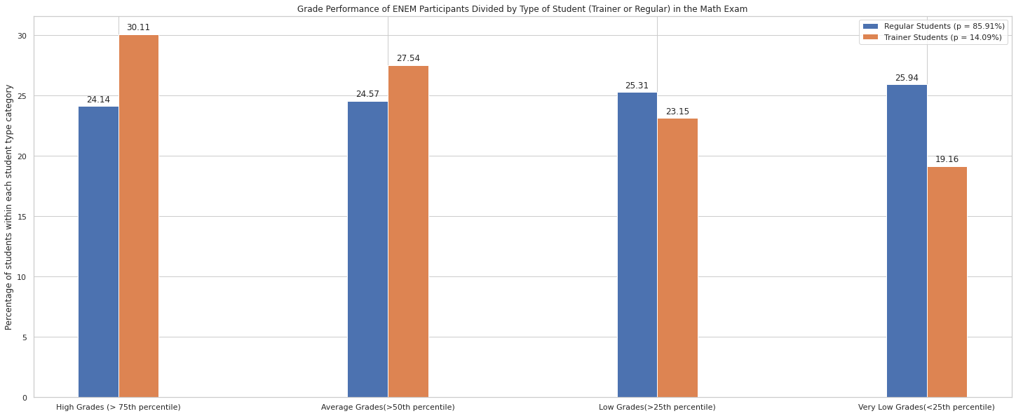
Hypotheses Results – Hypothesis 7
Obs.: Similar graphs occurred for all other subjects with different gaps between student types
Hypotheses Results
Problem Framing
Hypotheses
Prediction Models

Slide 21
Hypotheses Results – Overall Observations
Why is essay so different (more uniform throughout grades) than other subjects when regions are compared?
Public school students present close percentage values in all grade categories apart from high grades
Average grades is a transition category in most hypotheses
Student groups percentages converge (are these features poor at predicting grades in this category?)
Income ranges discrepancies:
Low-income percentages vary little throughout grades (should it be even more detailed/divided?)
Income, parents' level of education and internet access are key for a high performing student
The Hypothesis 6 (Age range) provided ambiguous results:
For some subjects there was a clear age range where grades were better, for others the gaps were smaller
Hypothesis 7 presents small gaps and little differences between grade categories (close percentages)
Hypotheses Results
Problem Framing
Hypotheses
Prediction Models

Slide 22
Prediction Models - Strategy
Model: XGBoost Regressor
Creation of benchmark model (Model 0):
All possible features (91 features)
Feature importance analysis
Reveal of important features ignored in hypothesis
Model merging best features from hypotheses and feature importance analysis (Model 1)
Model using only features from hypotheses (Model 1.1):
Check of high-level hypothesis
Feature engineering:
NU_IDADE: Grouping up in ranges
TP_SEXO: Letter characters to integers
TP_ANO_CONCLUIU: Grouping up in ranges
CO_UF_PROVA: Grouping up states into regions
Q001 to Q025: Grouping up / categorical variables into numeric
Prediction Models
Problem Framing
Hypotheses
Hypotheses Results

Slide 23
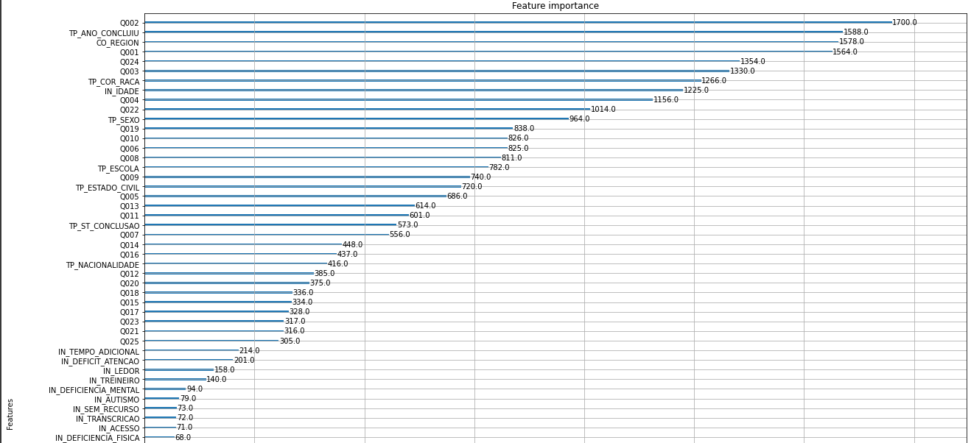
Prediction Models – Model 0 Feature Importance
Prediction Models
Problem Framing
Hypotheses
Hypotheses Results

Slide 24
Prediction Models – F.I. Observations
TP_ANO_CONCLUIU (High school conclusion year) ranked very high:
Finer feature for the effects caused by age of students
Q024 (No. of computers):
Encompasses internet access and will replace it, as well as portraying social-economic differences
Q002 more important than Q001:
In Brazil, mothers usually are more present as a parent
TP_COR_RACA ranking high:
Portrait of racial differences in Brazil
Structural prejudices should always be considered an important factor for checking (e.g. possible xenophobia against Arabic populations in France)
Many features from the social-economic survey (Q0XX):
Most of them reflect economic gaps (e.g. number of TV sets in the household)
Prediction Models
Problem Framing
Hypotheses
Hypotheses Results

Slide 25
Prediction Models – Model 1
Features included:
Ranking more than 900 in the F.I. analysis of Model 1
Hypotheses features
List of features:
Q001
Q002
Q003
Q004
Q006
Q022
Q024
TP_ANO_CONCLUIU
CO_REGION
TP_COR_RACA
IN_IDADE(Grouping up of ages)
TP_SEXO
IN_TREINEIRO
Prediction Models
Problem Framing
Hypotheses
Hypotheses Results

Slide 26
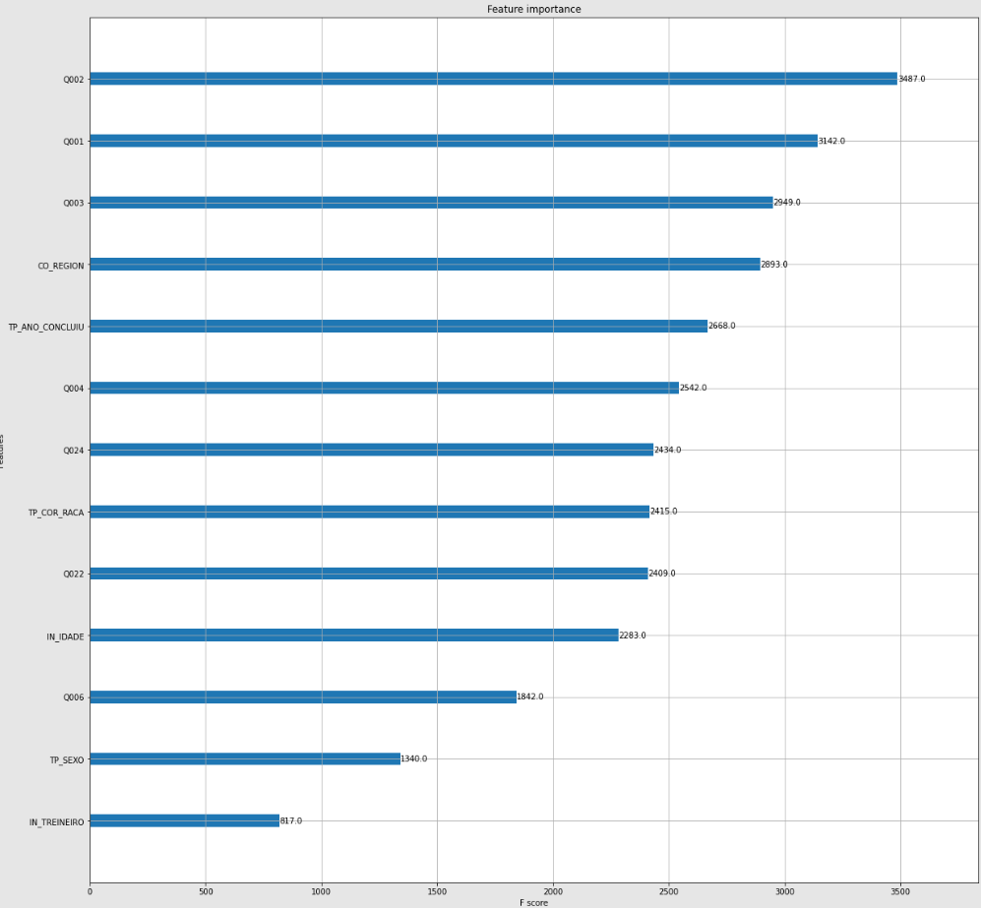
Prediction Models – Model 1 Feature Importance
Prediction Models
Problem Framing
Hypotheses
Hypotheses Results

Slide 27
Prediction Models – Model 1.1
Features included:
Hypotheses features
List of features:
Q001
Q002
Q006
Q024
CO_REGION
IN_IDADE
IN_TREINEIRO
Prediction Models
Problem Framing
Hypotheses
Hypotheses Results

Slide 28
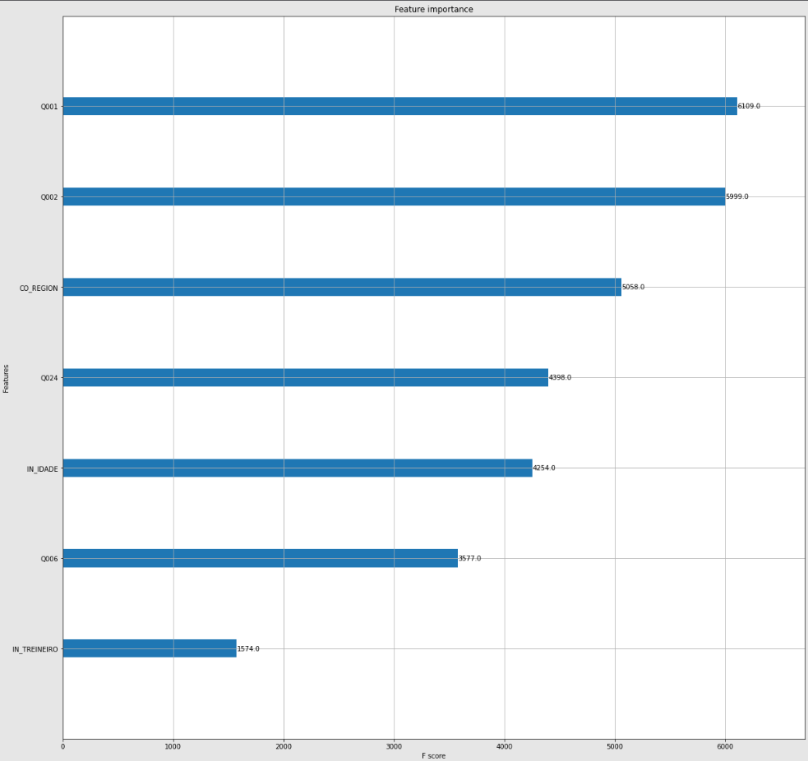
Prediction Models – Model 1 Feature Importance
Prediction Models
Problem Framing
Hypotheses
Hypotheses Results

Slide 29
Prediction Models – Model Results
Evaluation Metric: Root Mean Squared Error (RMSE)
Time for execution (approximate):
Model 0: 45 minutes
Model 1: 11 minutes
Model 2: 6 minutes
Models | Evaluation Metric | Natural Sciences | Human Sciences | Mathmetics | Languages | Essay Exam
Model 0 (Benchmark) | RMSE | 64,2 | 69,1 | 89,6 | 52,4 | 136,6
Model 1 | RMSE | 65,1 | 69,9 | 90,8 | 53,1 | 138,3
Model 1.1 | RMSE | 66,6 | 71,3 | 94 | 54,3 | 141,1
Prediction Models
Problem Framing
Hypotheses
Hypotheses Results

Slide 30
Prediction Models – Questions / Next Steps
How to improve model results?
Model 0 performed slightly better than Model 1 and 1.1 (but took way more computational time to run)
Perform more steps of feature engineering at chosen features?
A feature importance analysis could substitute good hypotheses formulation?
Hyperparameters were not changed:
Next step: hyperparameter tune tree booster parameters of XGBoost model
Model was created only with train and test sets:
Would an evaluation set improve the model?
Other suggestions??
Prediction Models
Problem Framing
Hypotheses
Hypotheses Results

